Slide 1
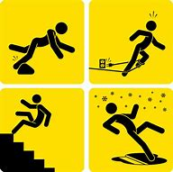
General Health and Safety Risks in IT
Darren Lee
Slips and trips
Slips and trips involve people slipping or tripping on certain things for instance, a spill or something that is jutting out of a stair. Staff and any visitors that may visit the premises can be injured if they encounter a slip and trip hazard. Ways that this can be managed is to ensure that there is general good housekeeping is being carried out. Ensure that all areas are lit with sufficient light. Staff keep there work places clean and not cluttered.

Slide 2
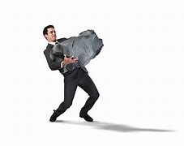
General Health and Safety Risks in IT
Manual handling
This comes under a health and safety risk because there's things that can overload what the person can actually do. Examples of this include getting someone to load a weight he/she can not physically carry. This could lead to back or other muscle damage or worse. To combat this you will need to have staff awareness of safe manual handling techniques and loads restricted to capabilities. Training should be provided to people who are required to carry out lifting activities.

Slide 3

General Health and Safety Risks in IT
Display Screen Equipment
This is an issue because people who have incorrect posture, a bad layout or bad seating can lead to people with bad backs or people sitting uncomfortably which can lead to medical issues down the line. To solve these issues, it is recommended to have a analysis of individuals work stations, layouts, postures and seating.

Slide 4
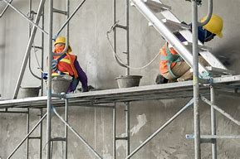
General Health and Safety Risks in IT
Work at height
This is a major issue cause falling at high heights or objects falling on a person at a high height. To solve this issue, where possible, you can restrict storage at height by how heavy it is. You can also provide training on how to use a ladder. There should be clear access to and at storage areas and systems. These storage systems should be secure. Suitable access equipment should be available for instance guard rails. The equipment must also be checked to remove then if there in a unsafe condition.

Slide 5
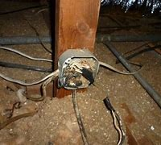
General Health and Safety Risks in IT
Electricity
This risk applies to anyone who is using or coming into contact with electrical devices or appliances. If used unsafely it can lead to burns, fire and death at worst cases. Ways to solve these issues is to have a appropriate level of maintenance (inspection and, where necessary, PAT testing). Extension cables should only be used as a temporary measure and positioned away from areas of potential damage. There should be a sufficient number and position of fixed socket outlets. And unavoidable wires and cables should be covered with cable matting or some other form of protection.

Slide 6
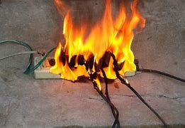
General Health and Safety Risks in IT
Fire
Fire is a dangerous issue and must be dealt with immediately. Everyone is at risk with a fire so there's certain actions that need to be put in place by law. All areas in the building must be included in the fire risk assessment. There has to be designated smoking sights to reduce setting off fire alarms and setting off fires with lit ash. Rubbish should not be allowed to over accumulate and good housekeeping should be ensured through regular checks. Portable heaters should be temporary and checked for condition and location prior to being used. There should be a sufficient number of plug sockets and placed around efficiently to reduce the need for extension cables

Slide 7
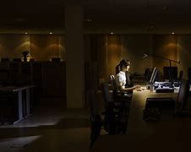
General Health and Safety Risks in IT
Lone working and working outside of normal hours
Lone working can be a small issue because if there is something that is dangerous and the worker is injured and has nobody to help him there. To solve these issues most places will need requirements to easy emergency assistance for example phones around the offices. Also if working alone the job must be low risk for instance just typing up a form, not moving large quantities of heavy objects.

Slide 8
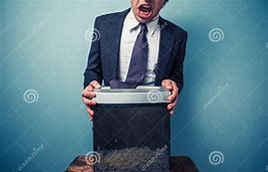
General Health and Safety Risks in IT
Use of office equipment
This is a issue because users can be shocked, hurt and at most, loss of limb or death. Ways this can be reduced and prevented is to make sure people use the equipment to the manufacturers instructions. People who handle the more complicated equipment should receive training on how to use it and how to fix it if necessary. The equipment should be periodically checked for safety concerns and taken out of use if damage is found. Loose clothing or long hair must be kept away from moving parts.

Slide 9
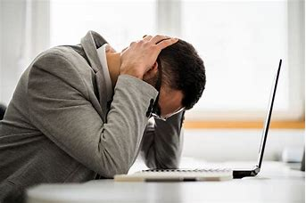
General Health and Safety Risks in IT
Work related stress
This can cause lots of mental issues, like stress of getting fired cause of overdue work, or physical issues, like eye strain from spending too much time on the screen because of lots of work. This can all be prevented by making sure people do not have prolonged periods of excessive demands. Make sure that all people have a role and can support each over if needed. Make sure there is no harassment or poor relationships with other people and have assessments on levels of stress within people.

Slide 10
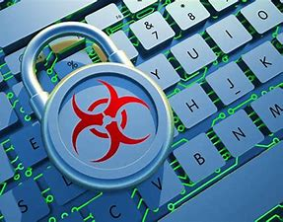
General Health and Safety Risks in IT
Malicious content and safety of users data
This is a legal issue which needs to be put in place no matter what and has to have action taken against if something is wrong. This is because if your working in a IT industry there’s high chances of you needing to put in personal information you want to be safe. If this information is leaked it could lead to many issues. Ways people can get this information is to make sure you have the appropriate security within the IT system and have a regular evaluation of the security. You should install a anti virus and regularly update software. You should also know what clients and other users are downloading onto the computers and look at there search history and monitor downloads and clicks online.

Slide 11
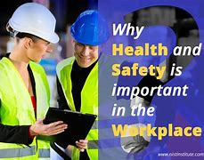
Importance of health and safety in the workplace
The importance of health and safety in the workplace simply cannot be overstated. It is not just the law, but it is also part of being a decent employer to ensure that your employees are not injured as a result of the work they do for you. Health and safety is crucial not only for your employees, but also for any visitors, customers, subcontractors, and members of the general public who may work for you, do business with you, or come into touch with your organization in any way.

Slide 12

Who to report to
You should report all health and safety issues to a higher command, for instance your employer or boss. This is so it can get taken care of immediately.

Slide 13
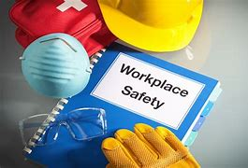
Importance of health and safety recording
It's critical to keep good health and safety records for the following reasons: It ensures that the Company can demonstrate compliance with the legal obligations under health and safety law (both internally and externally); In many circumstances, it is a legal need to have certain health and safety records on hand for examination.

